Slide 1

English for Information Technology
Dept of information management, Yuanze University
Week
2

Slide 2

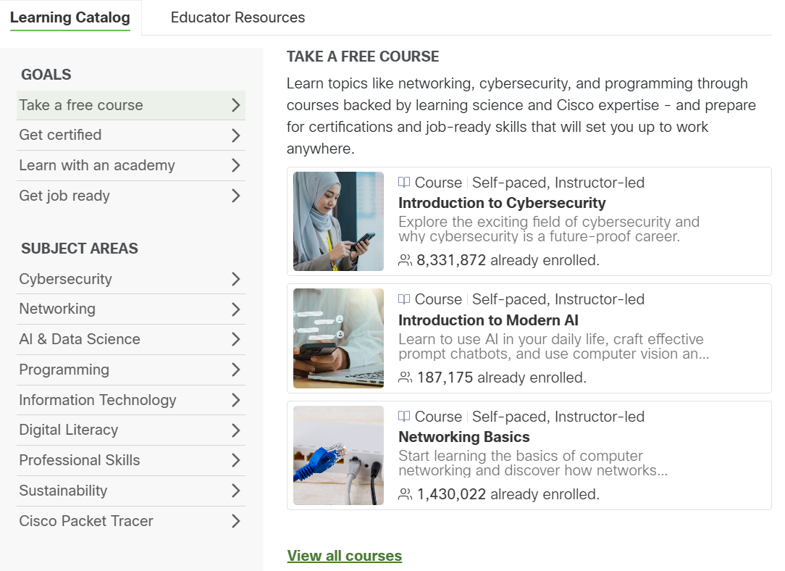
Any Update on CN Academy?
AI & Data Science
Information Technology
Professional Skills
Digital Literacy

Slide 3
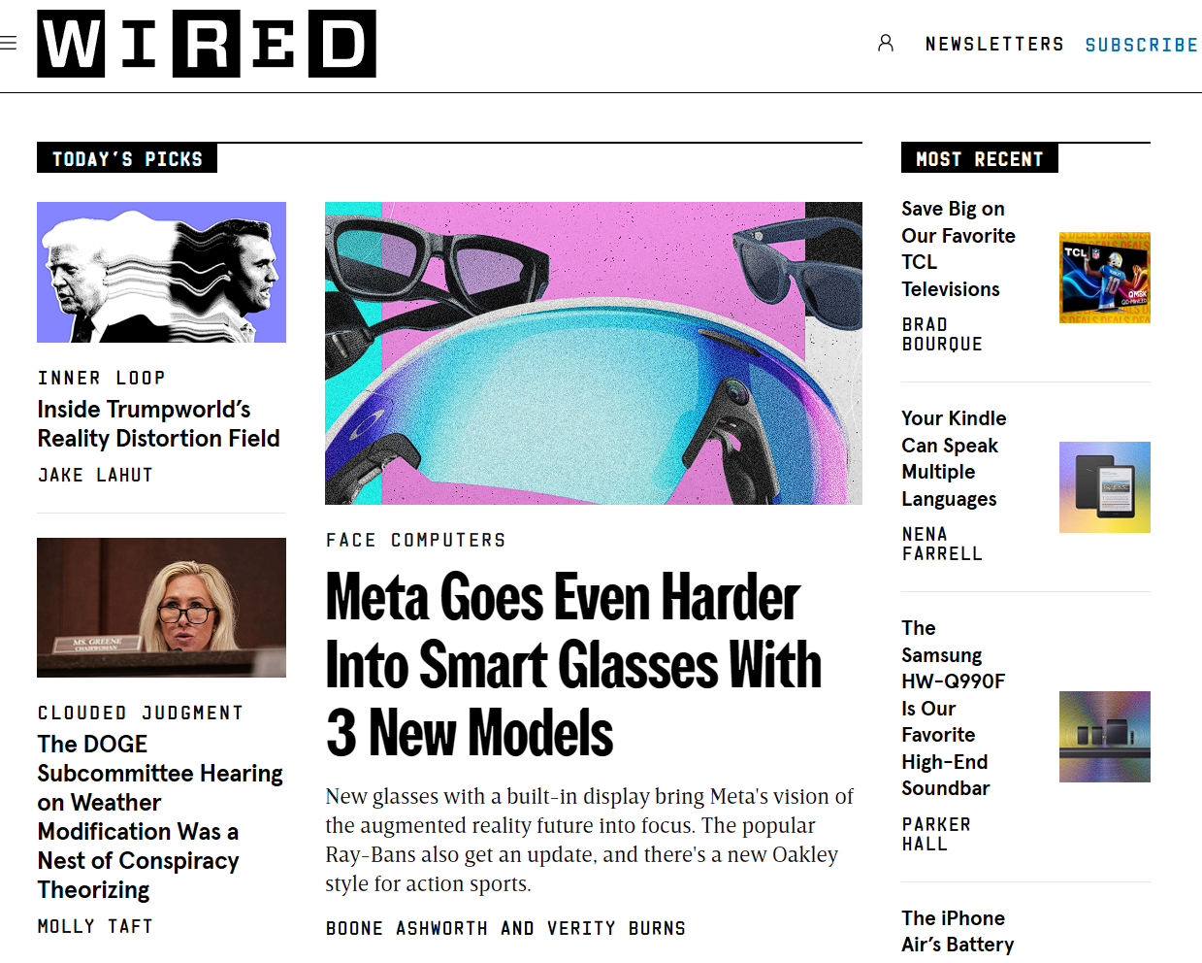
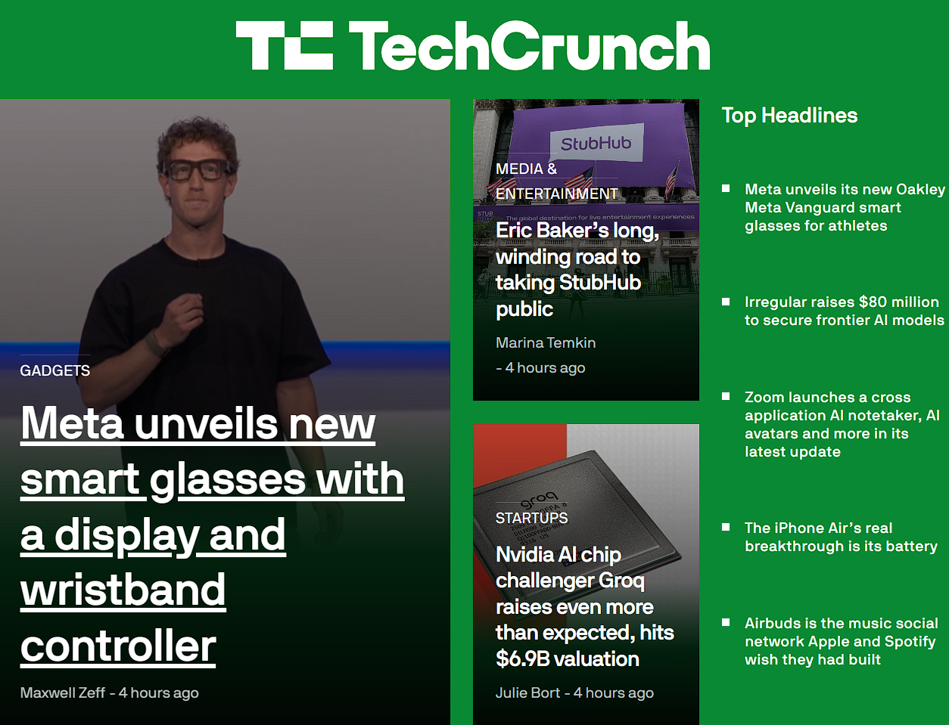
On headline today

Slide 4
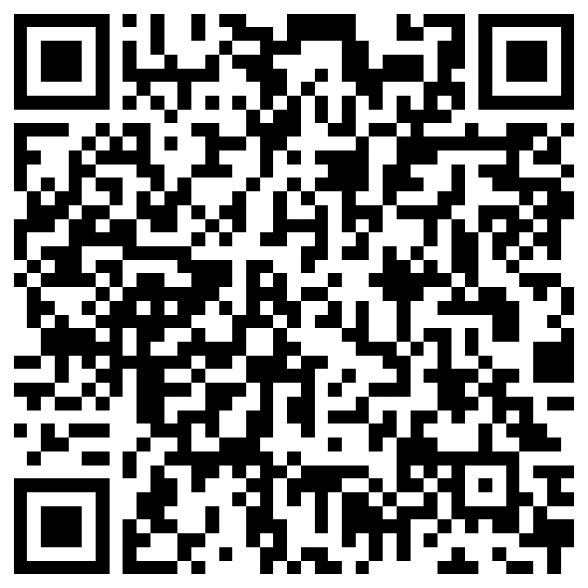
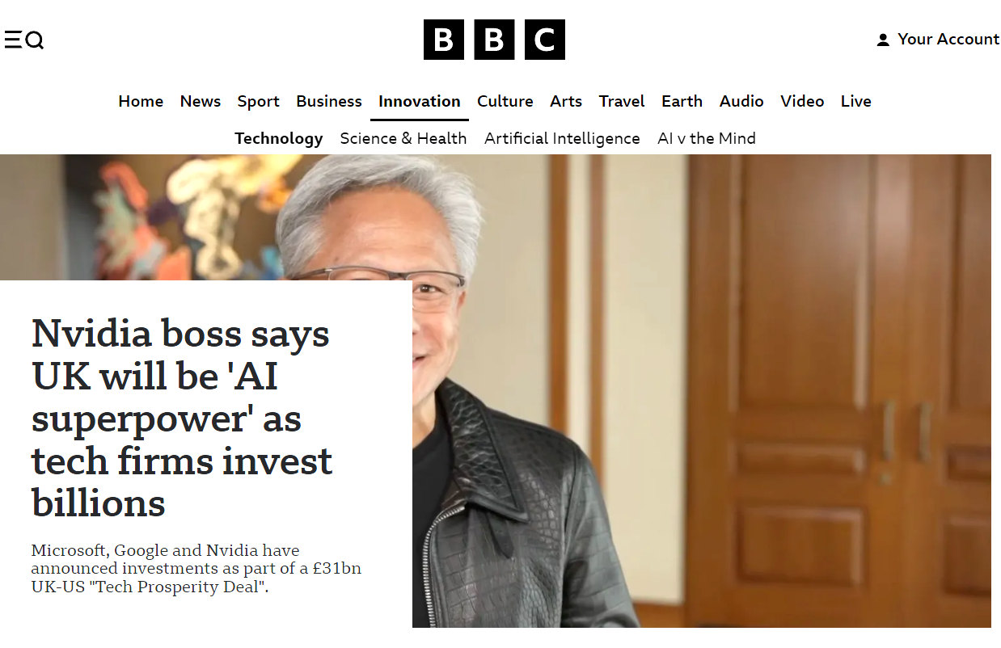
Online resources for today
Original Article

Slide 5
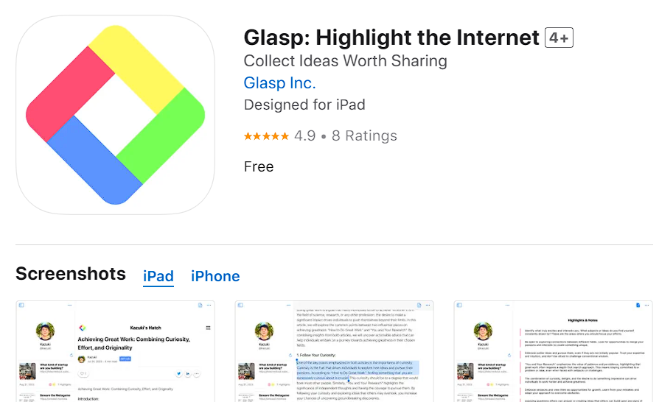
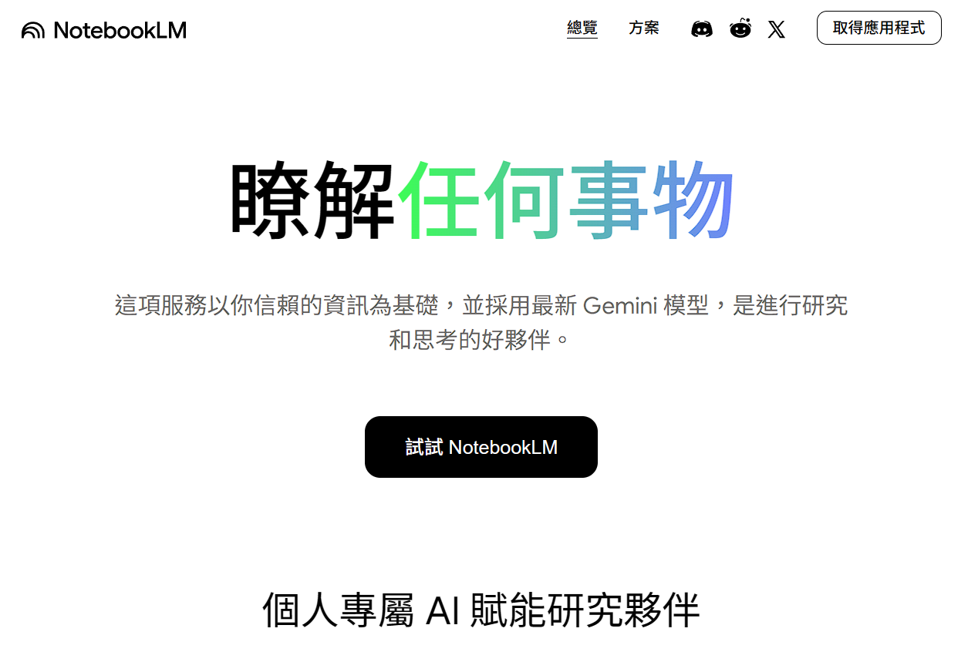
Tools used

Slide 6
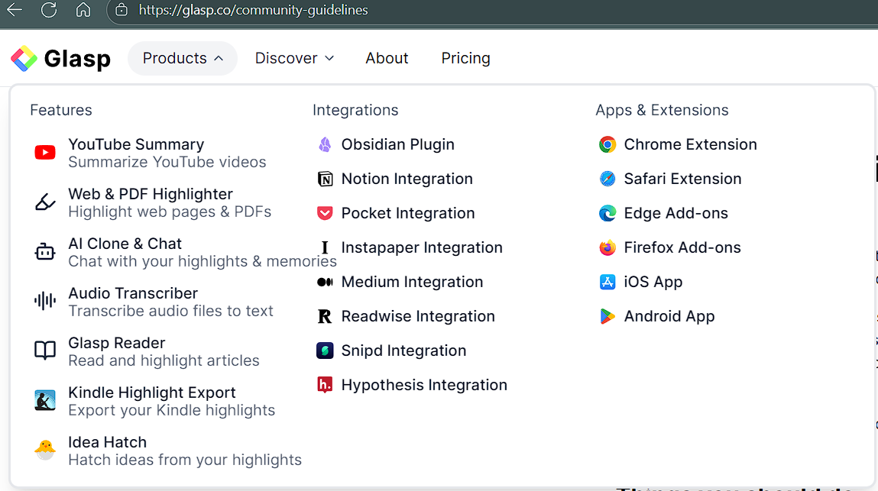

Slide 7
